Slide 1


Tag Clouds for Object-Oriented Source Code
Visualization
Ra'Fat Al-Msie'deen
Department of Computer Information Systems, Faculty of IT
Mutah University, Karak, Jordan
speaker: YingJian Xiao

Slide 2
Contents
01. Introduction
02. Related Work And Comparison With Iconic
03. Approach Overview
04. Tag Cloud Process Step By Step
05. Experimentation
06. Conclusion And Perspectives

Slide 3
1.Introduction
A tag cloud is a visual representation of textual content that uses color and size to point out word frequency . The tag is generally a single word. The importance of each tag is displayed with font size or colour.
identify tag clouds by using all software identifiers (i.e. packages, classes, attributes and methods).

Slide 4
1.Introduction
Iconic accepts the source code of software systems as input. Then, based on static code analysis, Iconic extracts all software identifier names. Then, it splits the identifier names into their constituent words. Then, it acquires the words’ roots. After that, it assigns weights to each tag based on its frequency across software code and stores the tags in a standard order. Finally, Iconic builds the tag cloud as output.

Slide 5
2.Related Work And Comparison With Iconic
References | References Method | Iconic Method
[9] | used tag cloud to visualize software classes. | visualizes software package, class, attribute and method names
[10] | In a tag cloud, if a tag name is selected, then the related source code elements in the graph visualization will be highlighted. | Iconic does not identify the link between tag in the cloud and the source code elements in the graph visualization.
[8,11] | explore the tag cloud using different layouts the tag cloud is customizable and the tool allows tag layouts to change | explore the tag cloud using a typewriter layout with tag names in alphabetical order
[13] | presents an automatic approach to extract software code labels. creates labels with the same font size and colour. | the tag frequency determines the tag font size in the tag cloud.

Slide 6
2.Related Work And Comparison With Iconic
References | References Method
[1] | Vsound depends on software identifiers to visualize, understand and document the software code. Vsound aims for a graphical representation of software code as a graphic-based document.
[14] | VariClouds is developed for helping software engineers in feature identification and naming.
[15] | REVPLINE approach
[17] | creates a tag cloud visualization of the text within a package, class or project with font size weighted by tag frequency and colors assigned arbitrarily.
[18] | Wordle is a tag cloud generator for any text. Wordle presents tags in the cloud without any pre-processing.

Slide 7
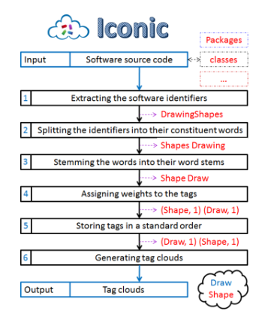
3.Approach Overview
Fig. 1. The tag cloud process, and a running example.

Slide 8
4.Tag Cloud Process Step By Step
A. Extracting Software Identifiers
Iconic uses the eclipse Java development tools and the eclipse abstract syntax tree to access, modify and read the elements of the software.
B. Splitting the Identifiers into their Constituent Words
Iconic uses the camel-case splitting algorithm, which splits words based on capital letters, underscores and numbers. Each identifier name is split into words based on the camel-case syntax.

Slide 9
4.Tag Cloud Process Step By Step
C. Stemming Words into their Word Stems
Stemming is a method of stripping affixes from words to form the word stem or base (e.g. performed to perform).Iconic uses WordNet dictionary to replace English words with their stems.
D. Assigning Weights to Tags
In this step, tag weight is assigned to each tag, based on its frequency of appearance in software identifiers.

Slide 10
4.Tag Cloud Process Step By Step
E. Storing Tags in a Standard Order
In Iconic, the tags within a tag cloud are arranged from left to right, and top to bottom. Iconic presents tags in a tag cloud in alphabetical order.
F. Generating Tag Clouds
This tag cloud contains all software identifier tags (i.e. package, class,attribute and method).

Slide 11
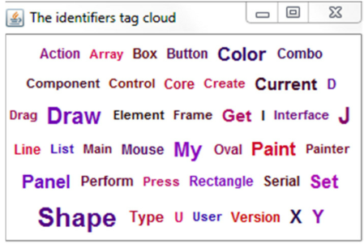
4.Tag Cloud Process Step By Step
Fig. 2. Tag cloud generated from drawing shapes software.

Slide 12
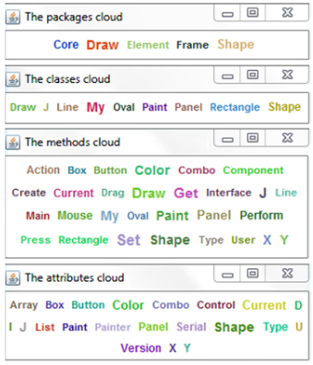
4.Tag Cloud Process Step By Step
Fig. 3. Different tag clouds extracted from Drawing Shapes software.

Slide 13
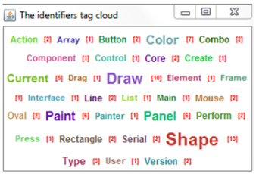
4.Tag Cloud Process Step By Step
Fig. 4. A tag cloud generated by using Iconic filters.

Slide 14
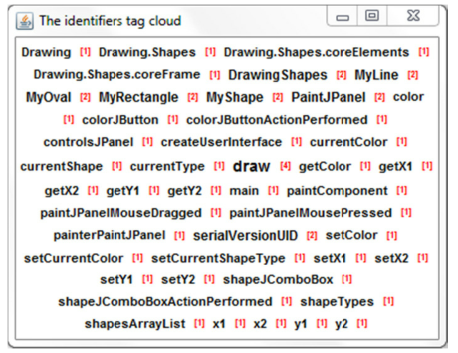
4.Tag Cloud Process Step By Step
Fig. 5. Tag cloud visualization created by Iconic.

Slide 15
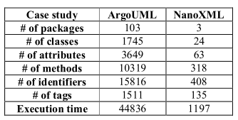
5.Experimentation
Table 1. Informatin About Tag Clounds Extracted From Case Studies .

Slide 16
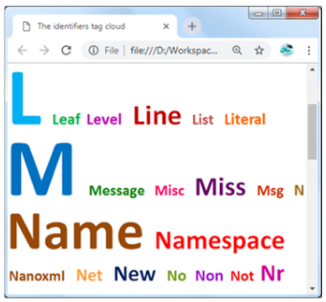
5.Experimentation
Fig. 6. Tag cloud extracted from NanoXML software.

Slide 17
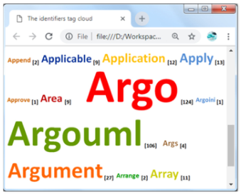
5.Experimentation
Fig. 7. Tag cloud extracted from ArgoUML software.

Slide 18
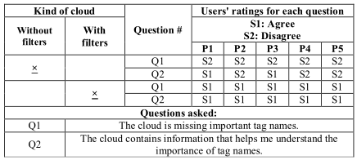
5.Experimentation
Table 2. The Design Of The User Study.All Participants
See Different Clounds For The Same Software.

Slide 19
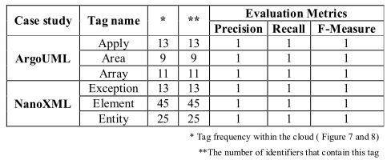
5.Experimentation
Table 3. Tags Mined From NanoXML And ArgoUML

Slide 20
5.Experimentation
The threat to the validity of Iconic:
(1)the current prototype considers only Java software
(2)when a software developer uses mix words to name software identifiers
(3)The WordNet may not be reliable in all cases to find the word stem.
(4)the tag clouds are missing some filters
(5) it would be much faster to be able to have a filtering search that the developer can type the tag to find it.

Slide 21
5.Conclusion And Perspectives
This paper proposed an original approach to visualize all software identifiers as a tag cloud.
For future work:
(1)support the current tag cloud with a set of user tasks , including tag searching, browsing, zooming and filtering.
(2)use other layouts for tag cloud such as spiral layout
(3)build a tag cloud using software identifiers and code comments and to identify the link between tag names and software identifiers.

Slide 22
THANKS

